Slide 1



UNIVERSITY INSTITUTE OF ENGINEERING
COMPUTER SCIENCE ENGINEERING
Bachelor of Engineering
Cloud Computing(CST-411)
Prepared By: Ms Himanshu(E11818)
Topic: Service Models of Cloud
Computing
DISCOVER . LEARN . EMPOWER

Slide 2
Learning Objectives & Outcomes
Objective:
To understand the different Service models of Cloud Computing
Outcome:
Student will understand
SaaS
PaaS
IaaS
XaaS

Slide 3

Service Models

Slide 4
Overview
Service Models
SaaS
Advantages of SaaS
PaaS
Advantages of PaaS
IaaS
Advantages of IaaS
XaaS
Advantages of XaaS

Slide 5
Service Models
Service Models are the reference models on which the Cloud Computing is based. These can be categorized into three basic service models as listed below:
Software as a Service (SaaS)
Platform as a Service (PaaS)
Infrastructure as a Service (IaaS)
Anything as a Service (XaaS)

Slide 6
Software as a Service (SaaS)
SaaS model allows to use software applications as a service to end users.
SaaS is a software delivery methodology that provides licensed multi-tenant access to software and its functions remotely as a Web-based service.
Usually billed based on usage
Usually multi tenant environment
Highly scalable architecture

Slide 7
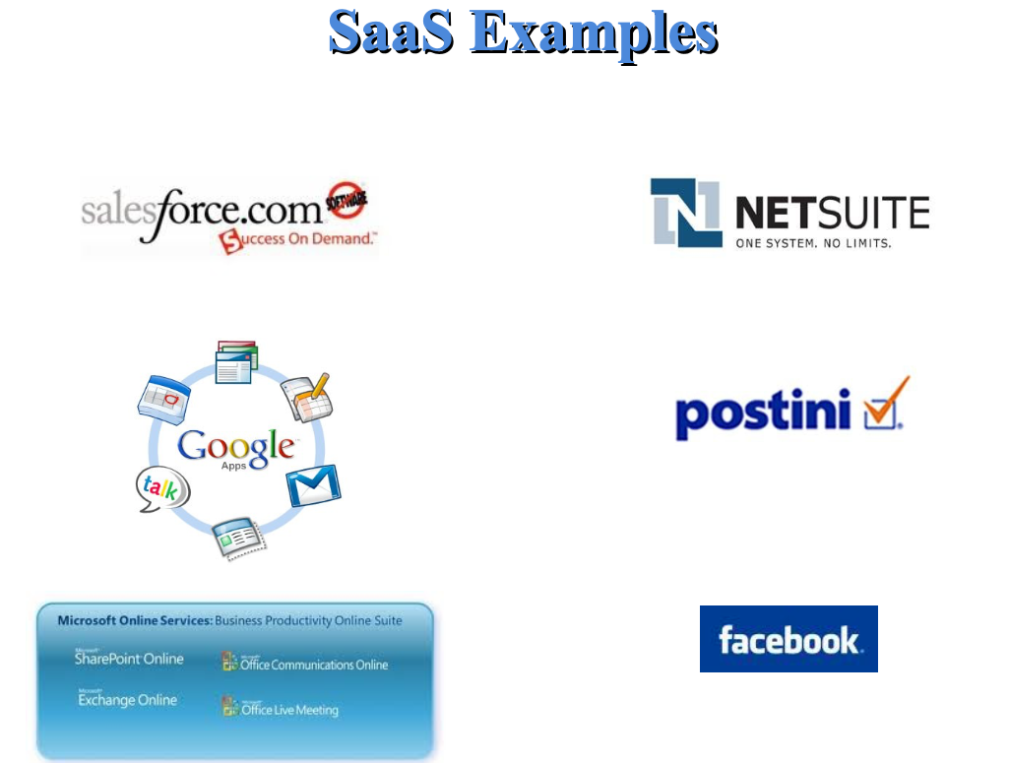

Slide 8
Advantages of SaaS
Cost Effective
Reduced Time
Accessibility
Automatic updates
Scalability

Slide 9
Platform as a Service (PaaS)
PaaS provides the runtime environment for applications, development & deployment tools, etc.
PaaS provides all of the facilities required to support the complete life cycle of building and delivering web applications and services entirely from the Internet.
Typically applications must be developed with a particular platform in mind
Multi tenant environments
Highly scalable multi tier architecture

Slide 10
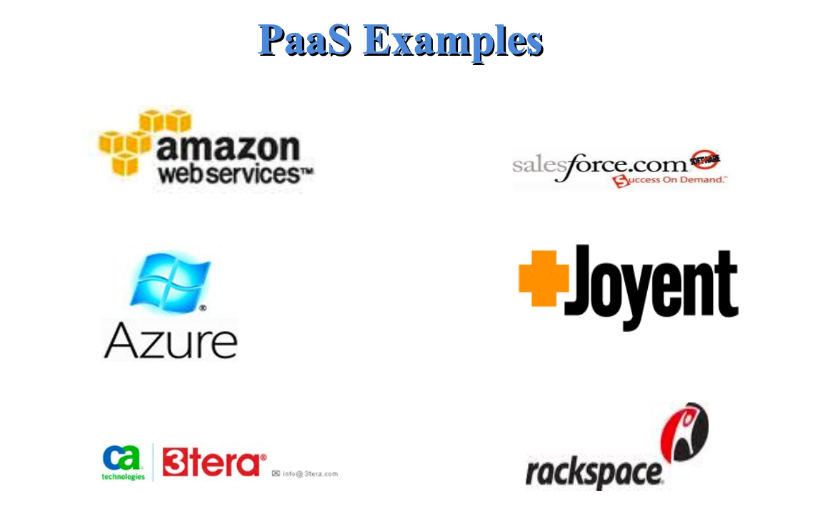

Slide 11
Advantages of PaaS
Simple and convenient for users
Cost Effective
Efficiently managing the lifecycle
Efficiency

Slide 12
Infrastructure as a Service (IaaS)
IaaS is the delivery of technology infrastructure as an on demand scalable service.
IaaS provides access to fundamental resources such as physical machines, virtual machines, virtual storage, etc.
Usually billed based on usage
Usually multi tenant virtualized environment
Can be coupled with Managed Services for OS and application support

Slide 13
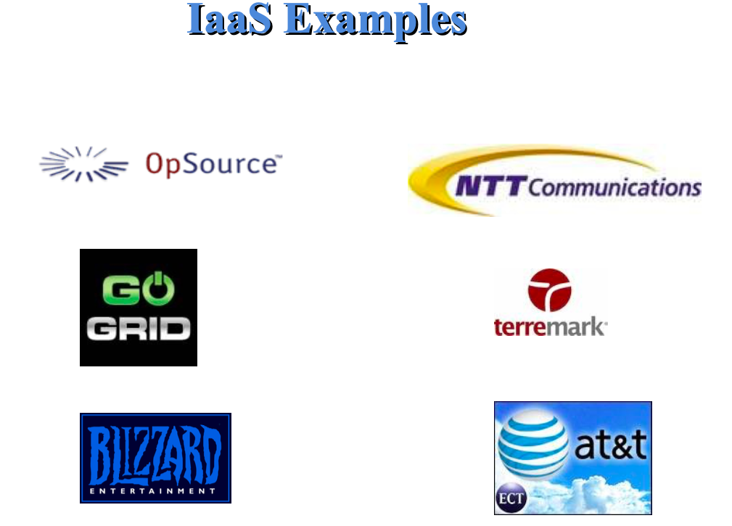

Slide 14
Advantages of IaaS
Cost Effective
Website hosting
Security
Maintenance

Slide 15
Anything as a Service (XaaS)
Most of the cloud service providers now a day offer anything as a service that is a compilation of all of the above services including some additional services.
Anything as a Service (XaaS) is a cloud computing term for the extensive variety of services and applications emerging for users to access on demand over the Internet.
XaaS term refers to delivery of anything as a service. In this model of cloud computing products, tools and technologies are delivered to users as a service over a network; typically, the Internet, rather than on-premises.

Slide 16
References
Text books:
Buyya, Rajkumar, James Broberg, and Andrzej M. Goscinski, eds. Cloud computing: Principles and paradigms. Vol. 87. John Wiley & Sons, 2010.
Miller, Michael. Cloud computing: Web-based applications that change the way you work and collaborate online. Que publishing, 2008
Websites:
https://www.geeksforgeeks.org/cloud-based-services/
https://www.tutorialspoint.com/cloud_computing/cloud_computing_overview.htm

Slide 17
THANK YOU

